Slide 1

B.TECH PROJECT PRESENTATION 2016
GAME DEVELOPMENT IN UNITY 3D USING C#
PROJECT ID - 7138
By
Debashis Pradhan 201210268
Ankur Upadhyay 201216265
Under the guidance of
Mr. Debanand Kanhar
Debashis Pradhan(201210268) & Ankur Upadhyay(201216265)
Notes:
B-TECH PROJECT MID-SEM PRESENTATION 2011
BY KHUSHBU KHAN & ISAN SAHOO

Slide 2
B.TECH PROJECT PRESENTATION 2016
PROJECT OVERVIEW
An interactive Video Game in Unity 3D using C#
Why Unity 3D
Audience
Scope
Objective
USP
Debashis Pradhan(201210268) & Ankur Upadhyay(201216265)
Notes:
B-TECH PROJECT MID-SEM PRESENTATION 2011
BY KHUSHBU KHAN & ISAN SAHOO
2

Slide 3
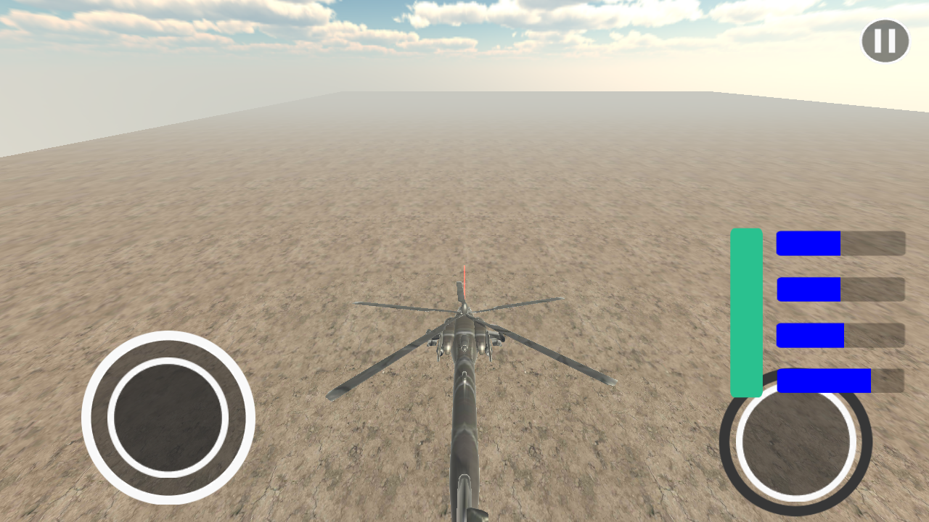
B.TECH PROJECT PRESENTATION 2016
IDEATION
A flight Simulator
Operation Neptune Spear Simulator
Debashis Pradhan(201210268) & Ankur Upadhyay(201216265)
Notes:
B-TECH PROJECT MID-SEM PRESENTATION 2011
BY KHUSHBU KHAN & ISAN SAHOO
3

Slide 4
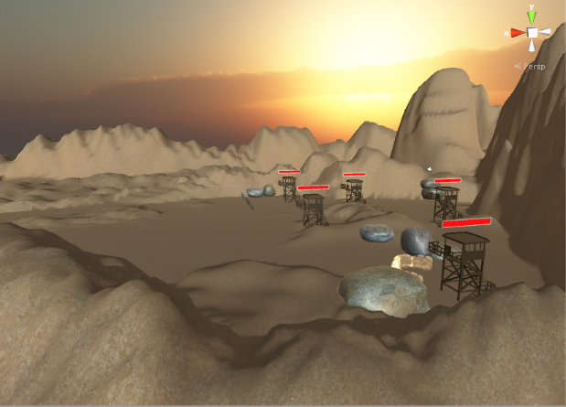
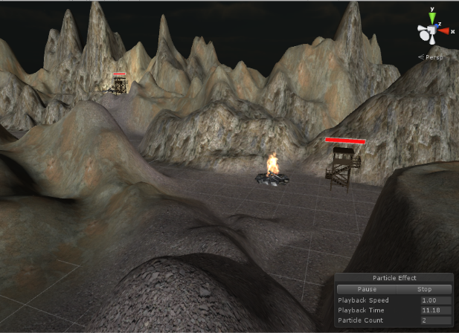
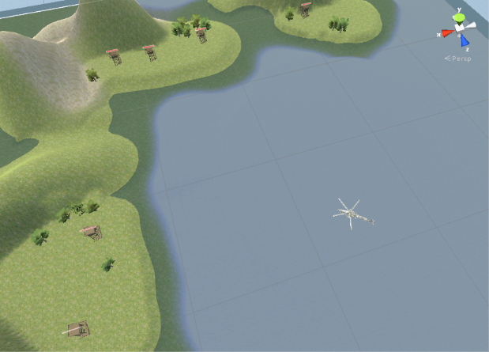
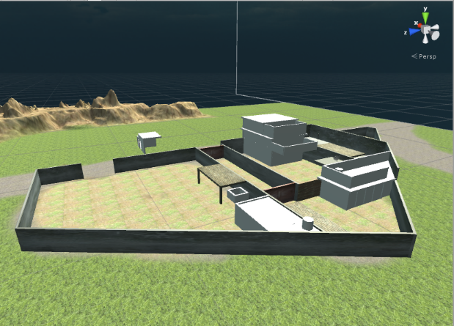
B.TECH PROJECT PRESENTATION 2016
STORYLINE
The Game is organized into levels.
Debashis Pradhan(201210268) & Ankur Upadhyay(201216265)
Notes:
B-TECH PROJECT MID-SEM PRESENTATION 2011
BY KHUSHBU KHAN & ISAN SAHOO
4

Slide 5
B.TECH PROJECT PRESENTATION 2016
GAME IMPLEMENTATION
Asset Creation and Acquiring
Mono-develop/Visual Studio
Images and GUI elements
Textures and other Downloadables
Debashis Pradhan(201210268) & Ankur Upadhyay(201216265)
Notes:
B-TECH PROJECT MID-SEM PRESENTATION 2011
BY KHUSHBU KHAN & ISAN SAHOO
5

Slide 6
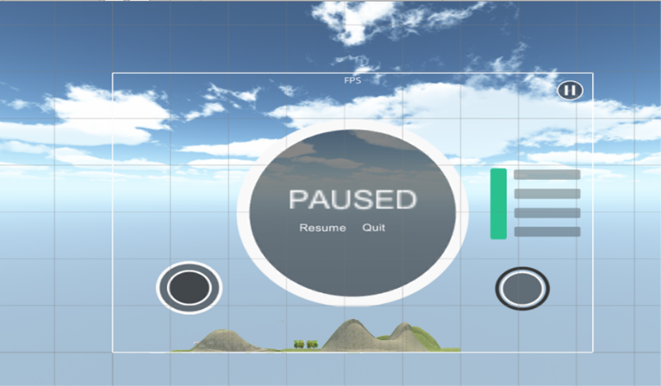
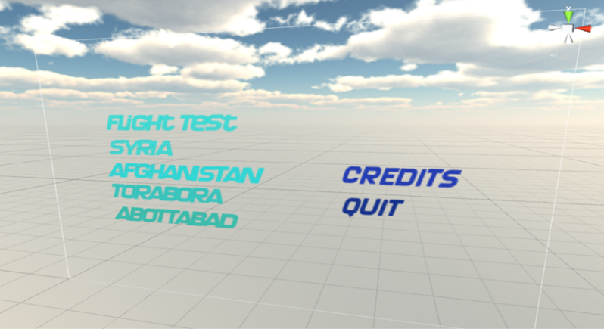
B.TECH PROJECT PRESENTATION 2016
GAME GUI
Joystick
Weaponry
Health and Other Parameters
Buttons
Pause and Quit Screen
Debashis Pradhan(201210268) & Ankur Upadhyay(201216265)
Notes:
B-TECH PROJECT MID-SEM PRESENTATION 2011
BY KHUSHBU KHAN & ISAN SAHOO
6

Slide 7
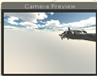
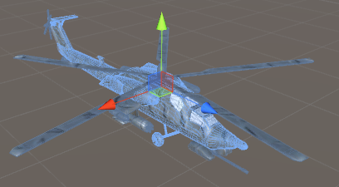
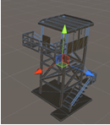
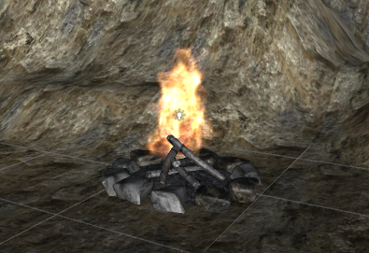
B.TECH PROJECT PRESENTATION 2016
LEVEL HIERARCHY
Debashis Pradhan(201210268) & Ankur Upadhyay(201216265)
Notes:
B-TECH PROJECT MID-SEM PRESENTATION 2011
BY KHUSHBU KHAN & ISAN SAHOO
7

Slide 8
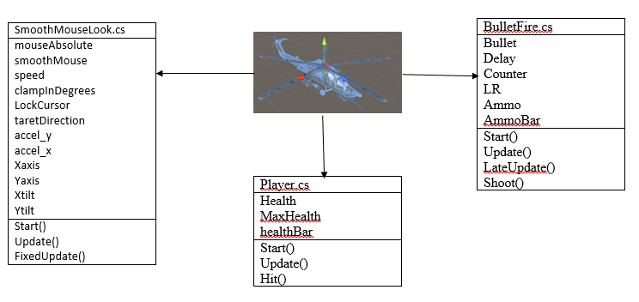
B.TECH PROJECT PRESENTATION 2016
GAME PROGRAMMING
Debashis Pradhan(201210268) & Ankur Upadhyay(201216265)
Notes:
B-TECH PROJECT MID-SEM PRESENTATION 2011
BY KHUSHBU KHAN & ISAN SAHOO
8

Slide 9
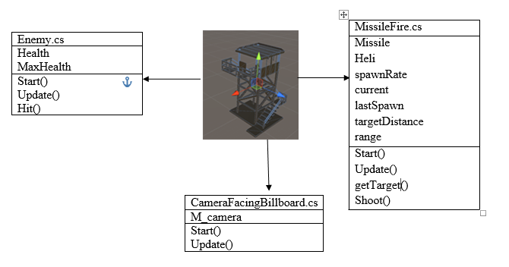
B.TECH PROJECT PRESENTATION 2016
Debashis Pradhan(201210268) & Ankur Upadhyay(201216265)
Notes:
B-TECH PROJECT MID-SEM PRESENTATION 2011
BY KHUSHBU KHAN & ISAN SAHOO
9

Slide 10
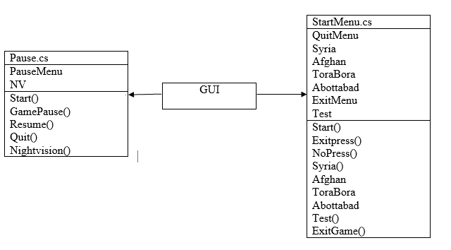

Slide 11
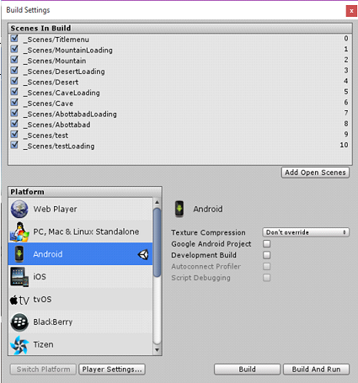
B.TECH PROJECT PRESENTATION 2016
BUILD AND DEPLOY
Debashis Pradhan(201210268) & Ankur Upadhyay(201216265)
Notes:
B-TECH PROJECT MID-SEM PRESENTATION 2011
BY KHUSHBU KHAN & ISAN SAHOO
11

Slide 12
B.TECH PROJECT PRESENTATION 2016
FUTURE WORK
The Following work can be continued on the Project.
Real Time Flight Simulator.
More Helicopter Models, Weapons, Armoury.
Ground Units and First Person Combat.
Debashis Pradhan(201210268) & Ankur Upadhyay(201216265)
Notes:
B-TECH PROJECT MID-SEM PRESENTATION 2011
BY KHUSHBU KHAN & ISAN SAHOO
12

Slide 13
B.TECH PROJECT PRESENTATION 2016
CONCLUSION
The following can be implemented in Unity easily.
A realistic flying chopper can be implemented in Unity.
Particle Effects, Light, Camera, Water, Fire.
Android Gaming Controls – Touch,Tilt
Debashis Pradhan(201210268) & Ankur Upadhyay(201216265)
Notes:
B-TECH PROJECT MID-SEM PRESENTATION 2011
BY KHUSHBU KHAN & ISAN SAHOO
13

Slide 14
B.TECH PROJECT PRESENTATION 2016
Thank you
Debashis Pradhan(201210268) & Ankur Upadhyay(201216265)
Notes:
B-TECH PROJECT MID-SEM PRESENTATION 2011
BY KHUSHBU KHAN & ISAN SAHOO
14

